Slide 1
Evaluating a Resident’s Advocacy Experience through a Unique Lens
Denise Warrick M.D., Brit Anderson M.D., Lisa Vaughn Ph.D.
Cincinnati Children’s Hospital Medical Center

Slide 2
Disclosure Statement
I have no relevant financial relationships with any commercial interests or other disclosures.

Slide 3
Resident Advocacy & Community Health
Two week pediatric residency rotation
Rotation occurs 7 times per year
Focused on advocating for the health, safety and well-being of children locally, nationally, and internationally
Curriculum consists of a variety of activities to practice essential advocacy skills
Course topics include:
Injury prevention, social determinants of health, primary care, community based participatory research and legislative advocacy activities
Notes:
The resident advocacy and community health experience at CCHMC is a 2 week rotation led by a multi-disciplinary group of instructors who are content experts in his/her field.
The course is focused on advocating for the health, safety and well-being of children locally, nationally, and internationally.
The curriculum consists of a variety of activities ranging from didactic lectures, small group discussions, field experiences, and individual projects to practice essential advocacy skills.
Course topics include injury prevention, social determinants of health, primary care, community based participatory research and legislative advocacy activities

Slide 4
Evaluation Techniques
Traditional evaluation method:
Lectures by the residents
Residents by instructors and course director
Current evaluation lacks detail and depth about learning and potential application of advocacy
Currently conducting a supplementary evaluation of the resident advocacy course using a modification of Photovoice methodology
Notes:
Traditionally, the individual lectures in the advocacy course have been evaluated by the residents.
The instructors and course director have evaluated the residents based on their participation and completion of projects.
While this information may be useful to understand resident satisfaction and participation, it lacks detail and depth about learning and potential application of advocacy.
Over the past two years, we have conducted a supplementary evaluation of the resident advocacy course using a modification of Photovoice methodology in order to better understand the residents’ perspectives, learning, and potential application of advocacy.

Slide 5
Photovoice
Technique commonly used in community-based participatory research and education action research^{1,2,3}
Participants are given cameras to document and then critically discuss their experiences⁴
Can be used as a tool for residents to explore what advocacy means to them and document their experiences during the rotation
Notes:
Photovoice is a technique commonly used in community-based participatory research and education action research where participants are given cameras to document and then critically discuss their experiences.
Photovoice can be used as a tool for residents to explore what advocacy means to them and document their experiences during the rotation, perhaps better than more traditional evaluation/debriefing methods.

Slide 6
Photovoice Methods
Each resident took up to 25 photographs of what advocacy means to them
At the end of each rotation we facilitated a Photovoice discussion group
At the end of the year (after 7 advocacy rotations) the photographs were grouped into themes
Notes:
During the advocacy rotation each resident took up to 25 photographs of what advocacy means to them
At the end of each rotation we facilitated a Photovoice discussion group where the residents shared their favorite photographs and discussed what they learned and will take away from their experiences during the course.
At the end of the year (after 7 advocacy rotations) the photographs were grouped into themes and selected photographs are displayed.

Slide 7
Findings/Results
Theme 1-Family & Community Context:
Because every community is different residents learned to recognize the importance of working collaboratively with community members, parents and children
Through neighborhood experiences residents learned that they must consider each family’s unique context including the community’s assets and limitations and their effect on health

Slide 8
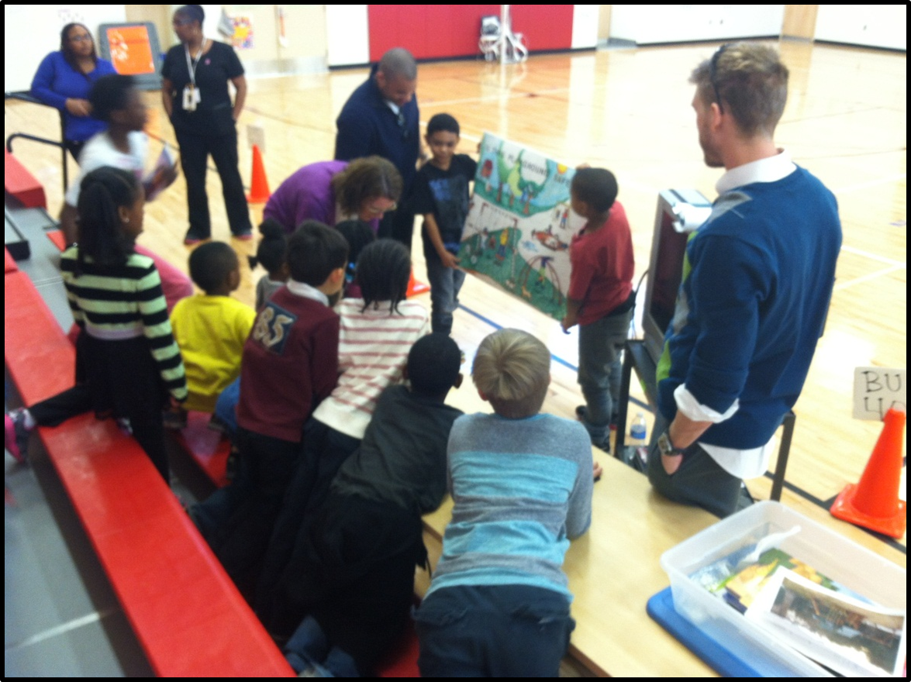
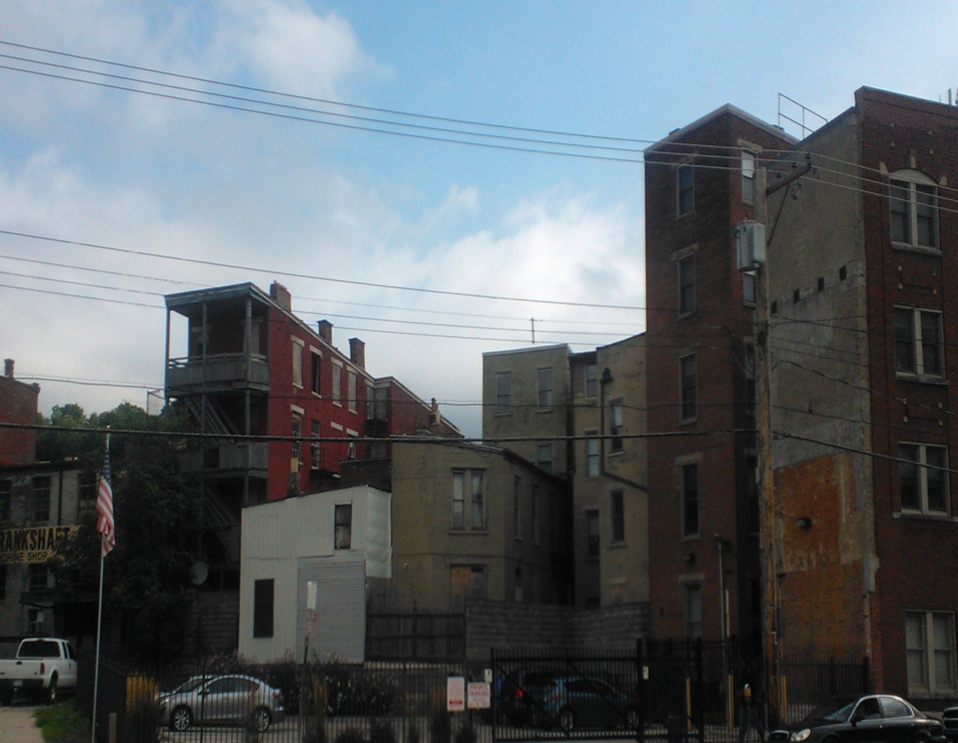
Theme 1-Family & Community Context
“The buildings pictured are dilapidated and worn. Windows are broken out, walls are missing, and the ground is rough and unpredictable. This is where my patients live , and it’s not always safe for children to play. This is a reminder of how meaningless our advice can be if we don’t consider the environment that gives it context.”

Slide 9
Findings/Results
Theme 2-Supporting a Family Is Expensive:
Providing essentials for children can be challenging for all families especially those with limited resources
Sometimes our recommendations to patients and their families (healthy food, medications, a safe place to play) may be more difficult than we realize for families to achieve

Slide 10
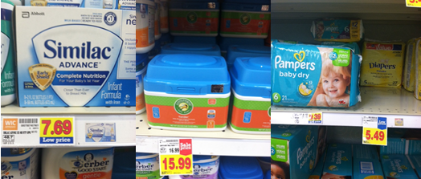
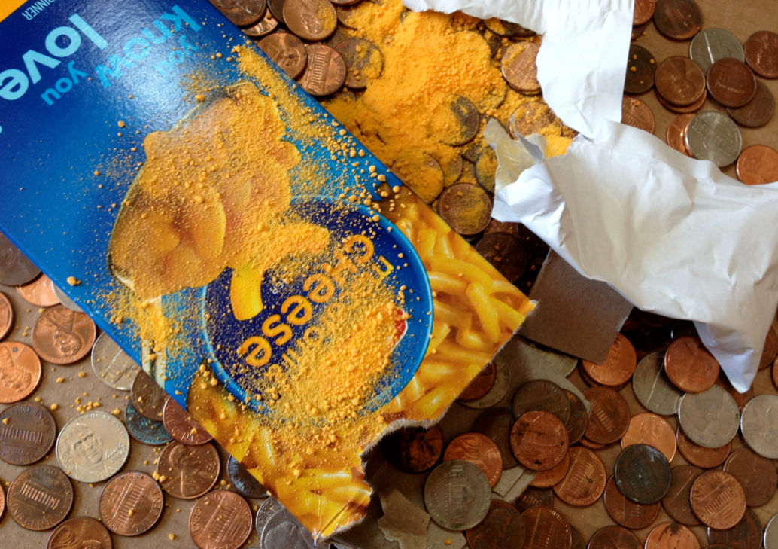
Theme 2-Supporting a Family Is Expensive
We learned that babies are expensive, and often help doesn’t go far enough. And Kroger brand is ok ☺
We encourage good choices for our families, but often convenience foods are more cost economical.

Slide 11
Findings/Results
Theme 3-Consideration of Available Resources:
Residents learned that they must consider a community’s resources, both the assets and limitations, when talking with and advocating for families who live in a particular community
Although there can be excellent community assets, residents realized the resources are not ideal and more needs to be done to meet the needs of the community

Slide 12
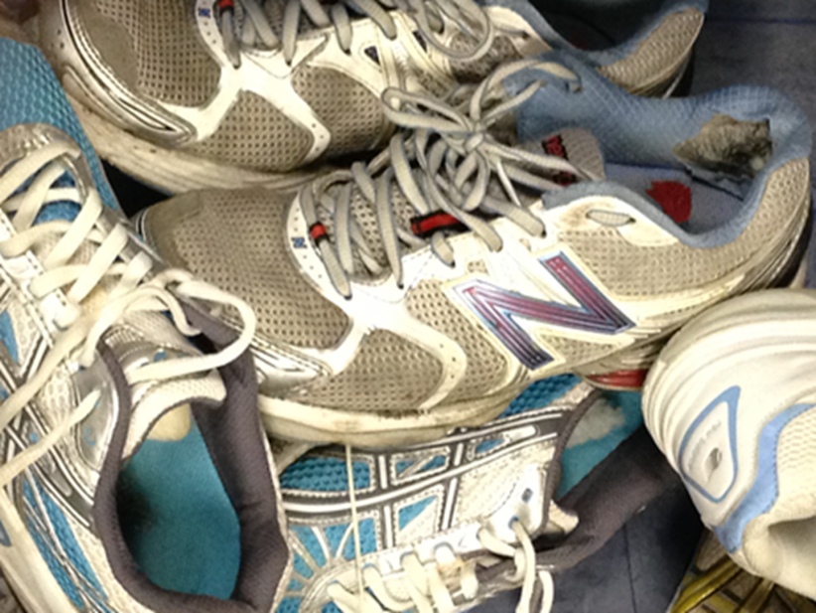
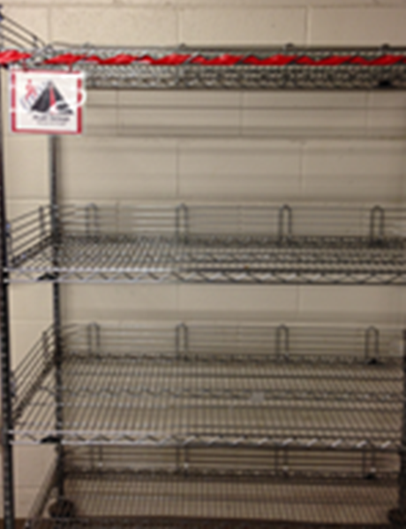
Theme 3-Consideration of Available Resources
It is difficult for me to comprehend anyone finding these shoes fit for donation, let alone finding them desirable to take home.
The “fruit group” shelf was completely empty. Again, we tell our patients to eat healthy foods; yet, their access to healthy foods is quite limited.

Slide 13
Findings/Results
Theme 4– Breadth and Depth of Advocacy:
From obesity prevention, car seats, playground safety, education to public policy being an advocate for children can take many forms and ranges from patient level to legislative advocacy.

Slide 14
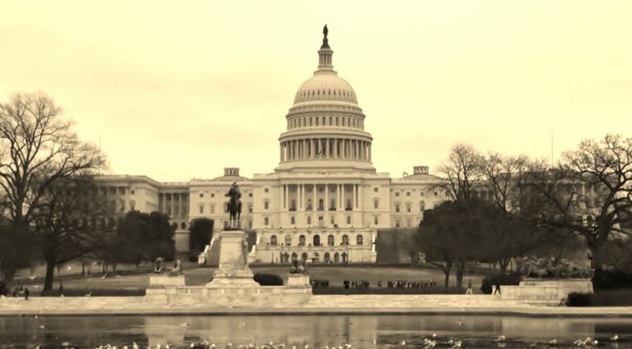
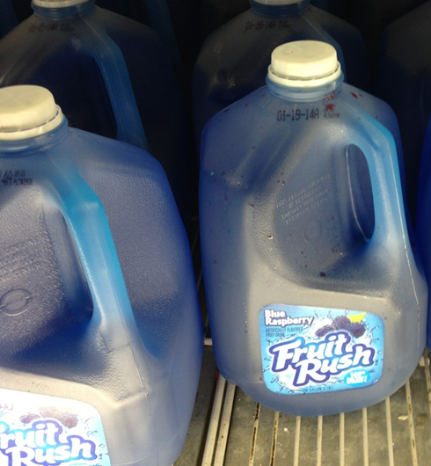
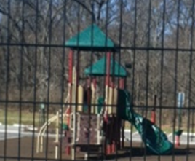
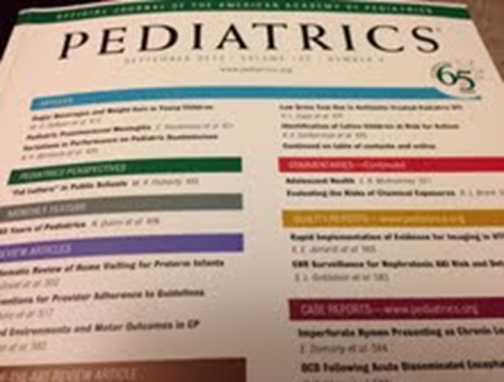
Theme 4– Breadth and Depth of Advocacy:
We can all be advocates for our patients by staying up to date on current research and literature.
We have some great playgrounds, and some that are just ok (and now we know the difference!)

Slide 15
Findings/Results
Theme 5-Advocacy Requires Teamwork and Collaboration:
Advocating for children often works best when done in multidisciplinary teams
Advocacy projects are complex and require different skills, backgrounds and perspectives to be successful

Slide 16
Theme 5-Advocacy Requires Teamwork and Collaboration
Notes:
Bike Helmet Safety Week

Slide 17
References
Catalani C & Minkler M. (2010). Photovoice : A review of the literature in health and public health. Heath Education &Behavior, 37(3), 424-251.
Wang C & Burris MA. (1997). Photovoice: Concept, methodology and use for participatory needs assessment. Health Education &Behavior, 24(3), 369-387,
Wang C, Yi W, Tao Z & Carovano K (1999). Photovoice: A particpatory action research strategy applied to wmoen’s health. Journal of Women’s Health, 8(2), 185-192.
Hergenrather KC, Rhodes SD, Cowan CA, Bardhoshi G & Pula S. (2009) . Photovoice as community-based participatory research: A qualitative review. American Journal of Health Behavior, 33(6), 686-698.

Slide 18
Questions?

